Slide 1


ROBOTIC ARM BASED ON MUSCULAR CONTROL
THEME:ROBOTICS
By,
SOEC G-(Batch No.2)
P.Vishnusai Vtu24998
P.Tarun Vtu25134
U.Prathap Vtu26917
K.Vijaykumar Vtu24964
T.Pavankumar Vtu25035
JVVV.Prasad Vtu26895
Guided by,
Dr G.Padmalaya
Assistant professor/ECE
Dr S.Jebarose juliyana
Assistant professor/MECH
Vel Tech Rangarajan Dr.Sangunthala R&D Institute of
Science & Technology

Slide 2
LIST OF THEMES:
T-1
ENERGY CONSERVATION
T-2
ROBOTICS
T-3
PUBLIC SAFETY
T-4
AGRICULTURE
T-5
INDUSTRY, INNOVATION AND INFRASTRUTURE
T-6
CLEAN WATER AND SANITATION
T-7
SUSTAINABLE CITIES AND COMMUNITIES
T-8
AFFORDABLE AND CLEAN ENERGY

Slide 3
SELECTED THEME: ROBOTICS
EXPLANATION:
ROBOTICS is a branch of technology that deals with the design,construction,operation,and application of robots
Robots are machines capable of carrying out a complex series of actions automatically, either programmed by a computer or using artificial intelligence.
Robotics is a sub-domain of engineering and science that includes mechanical engineering, electrical engineering, computer science, and others.

Slide 4
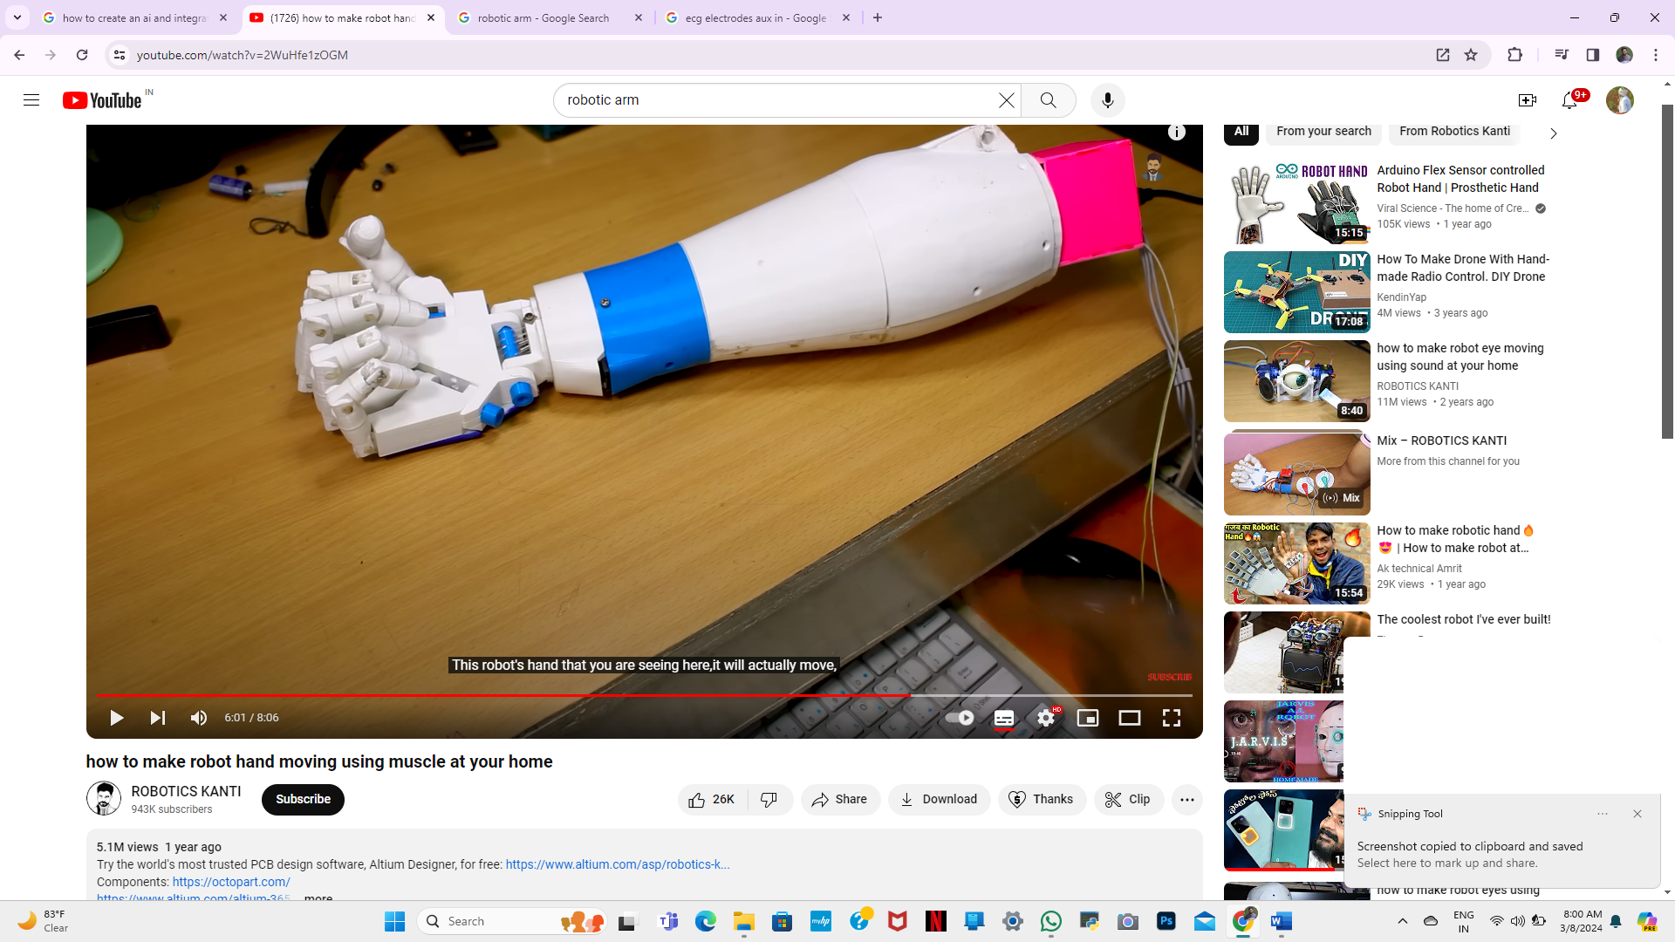
RELATION TO PROJECT
Project name is Robotic arm based on muscular movement .this project involve
construction,desgin,programming,circuits.
Our project main theme is to make affordable robotic arm for handicapped persons.
Project mainly involve three major streams computer science, electrical engineering,mechanical engineering.
Going the Anatomy project require several components they are: MG995servomotor,PCB,16MHZ,
10K resistor,22pf capacitors, IC base ,AD8232ECG sensor, ATMEGA328, ECG cable

Slide 5
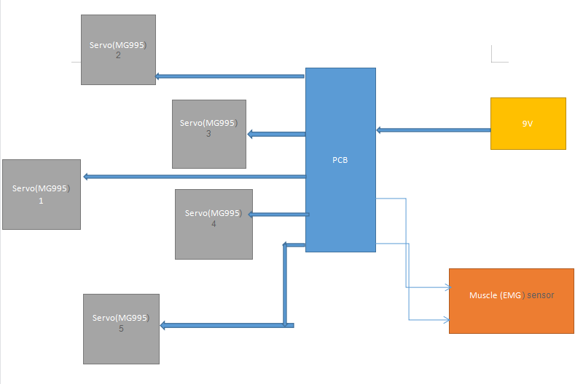
BLOCK DIAGRAM:-

Slide 6
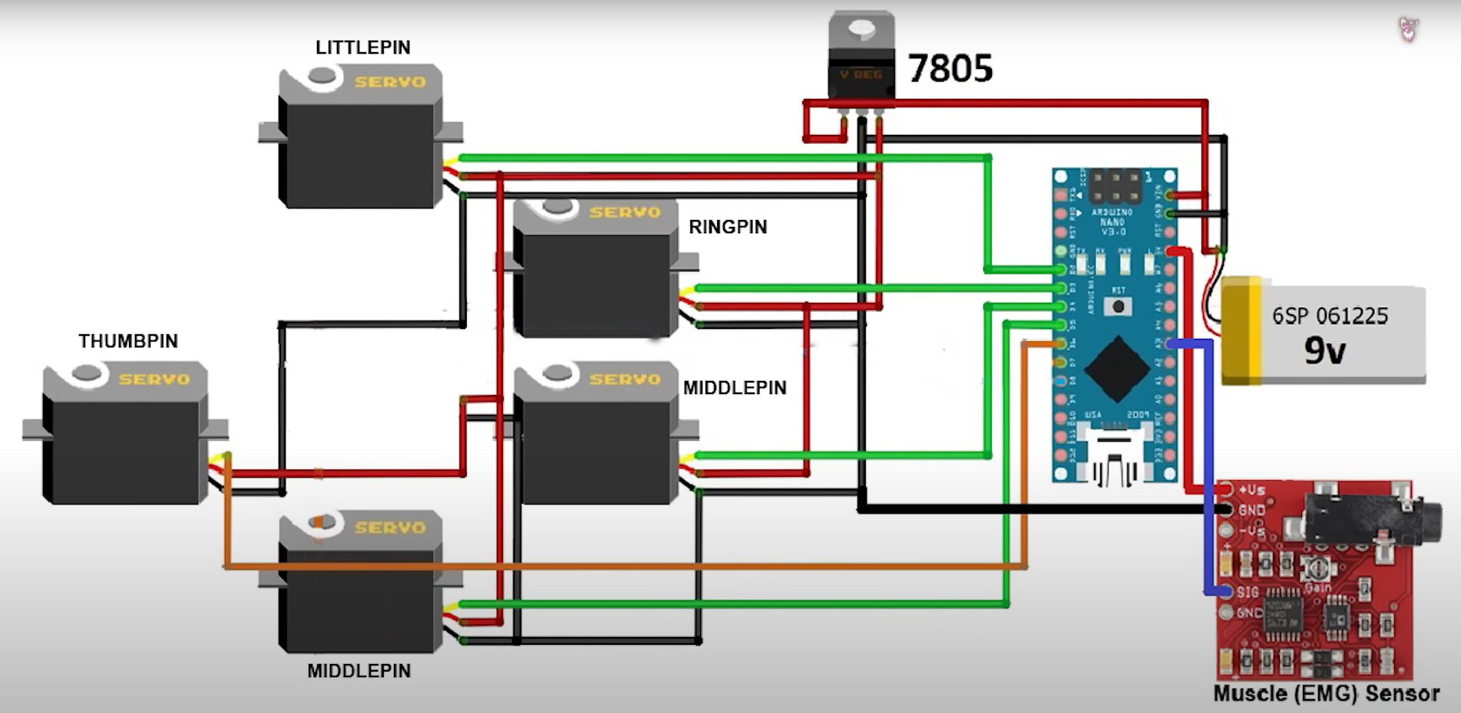
DIAGRAM / DESGIN:-

Slide 7
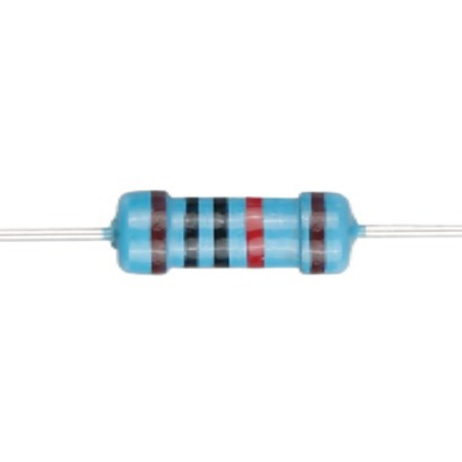
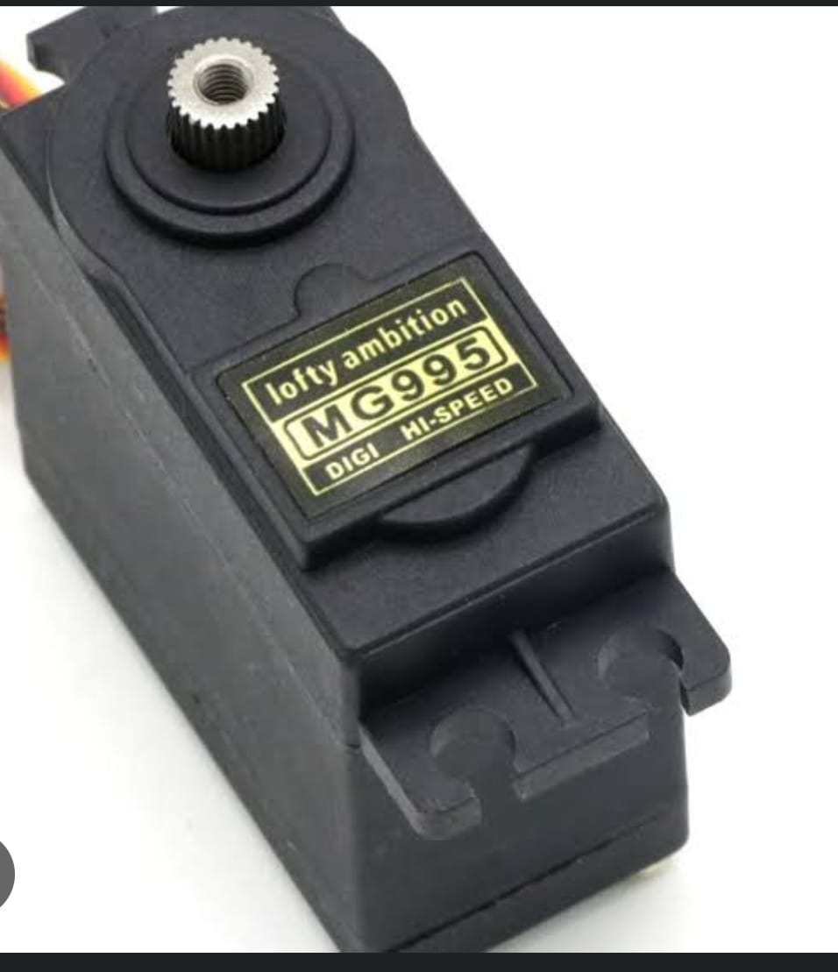
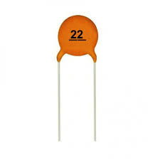
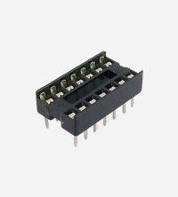
COMPONENTS:-
MG995SERVOMOTOR 10K RESISTOR 22pF CAPACITOR IC BASE

Slide 8
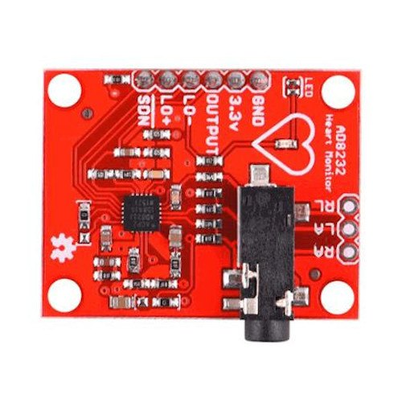
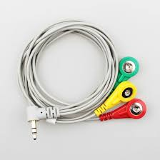
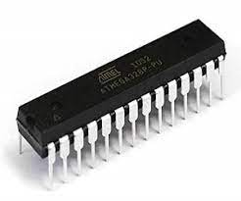
AD8232 ECG SENSOR ATMEGA328 ECG CABLE

Slide 9
WORKING
MG995SERVOMOTOR
MG995 Metal Gear Servo Motor is a high-speed standard servo can rotate approximately 180 degrees (60 in each direction) used for airplane, helicopter, RC-cars and many RC model. Provides 10kg/cm at 4.8V, and 12kgcm at 6V. It is a Digital Servo Motor which receives and processes PWM signal faster and better.

Slide 10
AD8232ECG SENSOR
The AD8232 is an integrated signal conditioning block for ECG and other biopotential measurement applications. It is designed to extract, amplify, and filter small biopotential signals in the presence of noisy conditions, such as those created by motion or remote electrode placement.

Slide 11
ATMEGA328
The ATmega328 is a single-chip microcontroller created by Atmel in the megaAVR family (later Microchip Technology acquired Atmel in 2016). It has a modified Harvard architecture 8-bit RISC processor core.

Slide 12
10KRESISTOR
A 10k resistor is a fundamental electronic component that plays a vital role in circuits by limiting the flow of electric current. Its resistance value is 10,000 ohms. These resistors are identified by a color code, typically brown-black-orange-gold, where each color represents a digit or multiplier.
22pFCAPACITOR
A 22pF 50V disc type Ceramic Capacitor. Use this capacitor for power decoupling, having a smooth power in your circuit, timing circuits, etc. It is always a good idea to put one of these next to the power pins of a microcontroller.

Slide 13
IC BASE
An IC base, also known as an integrated circuit socket, is a component used to connect integrated circuits (ICs) to printed circuit boards (PCBs). IC bases are used to hold an IC or other device and make electrical connections between the device and a circuit board.

Slide 14
PROGRAM CODE:-
#include <Servo.h>
#define THRESHOLD 150 //In order to determine the state of the hand (opened/closed)
#define EMGPIN 3 //Analog pin connected to Muscle Sensor V3 Board
#define LITTLEPIN 2 //Digital pin used by Little servo
#define RINGPIN 3 //Digital pin used by Ring servo
#define MIDDLEPIN 4 //Digital pin used by Middle servo
#define INDEXPIN 5 //Digital pin used by Index servo
#define THUMBPIN 6 //Digital pin used by Thumb servo
//Constants used to open and close the fingers
#define LITTLE 1
#define RING 2
#define MIDDLE 3
#define INDEX 4
#define THUMB 5
Servo servoLittleFinger; // Define servo fingers
Servo servoRingFinger; // Define servo fingers
Servo servoMiddleFinger; // Define servo fingers
Servo servoIndexFinger; // Define servo fingers
Servo servoThumbFinger; // Define servo fingers

Slide 15
int finger;
// Motion routines for handopen and handclose
void openhand(){for(finger = 1; finger < 6; finger++){openFinger(finger);}}
void closehand(){for(finger = 1; finger < 6 ; finger++){closeFinger(finger);}}
// You have to rewrite properly the functions to open and close the fingers
// according of your assembly
// In my case, middle and index fingers are opened when servo is at 170 degrees and the others when servo is at 0 degrees
// I have used Towardpro MG996R servos
void openFinger(int finger){
if(finger==LITTLE){servoLittleFinger.write(0);} // Little finger
else if(finger==RING){servoRingFinger.write(170);}// Ring finger
else if(finger==MIDDLE){servoMiddleFinger.write(170);}// Middle finger
else if(finger==INDEX){servoIndexFinger.write(170);}// Index finger
else if(finger==THUMB){servoThumbFinger.write(0);}//Thumb finger
}

Slide 16
void closeFinger(int finger){
if(finger==LITTLE){servoLittleFinger.write(170);} // Little finger
else if(finger==RING){servoRingFinger.write(0);}// Ring finger
else if(finger==MIDDLE){servoMiddleFinger.write(0);}// Middle finger
else if(finger==INDEX){servoIndexFinger.write(0);}// Index finger
else if(finger==THUMB){servoThumbFinger.write(170);}//Thumb finger
}
void setup(){
Serial.begin(115200); //BAUDRATE set to 115200, remember it to set monitor serial properly (used this BaudRate and "NL&CR" option to visualize the values correctly)
servoLittleFinger.attach(LITTLEPIN); // Set Little finger servo to digital pin 3
servoRingFinger.attach(RINGPIN); // Set Ring finger servo to digital pin 5
servoMiddleFinger.attach(MIDDLEPIN); // Set Middle finger servo to digital pin 6
servoIndexFinger.attach(INDEXPIN); // Set Index finger servo to digital pin 9
servoThumbFinger.attach(THUMBPIN); // Set Thumb finger servo to digital pin 10
}//end setup

Slide 17
void loop() {// Nothing to do here, all is done in the interrupt function
int value = analogRead(EMGPIN); //Sampling analog signal
if(value>THRESHOLD) //If the value of the sample is greater than THRESHOLD means that the hand has been closed
{closehand();}
else //Otherwise the hand is open
{openhand();}
Serial.println(value); //You can use serial monitor to set THRESHOLD properly, comparing the values shown when you open and close your hand
}

Slide 18
THE END…

